Slide 1
Vocational Training and its Role in Just Transition to Carbon-free Economies
Srinivas B, Reddy
Chief, Skills and Employability Branch (SKILLS)
Employment Policy, Job Creation and Livelihoods Department (EMPLOYMENT)
ILO, Geneva
6 October 2023

Slide 2
Objective and Structure
Key Questions
Why skills development is important for the green transition?
What kind of skills do we need for a greener future?
How can we make sure that the current and future workers are fully equipped with the relevant skills to better respond to the green transition?
Contents
Global policy context: ILO Just Transition Guidelines and Paris Agreement
The employment effect of greening the economy
Types of skills in demand in the green transition
Greening TVET and skills development

Slide 3
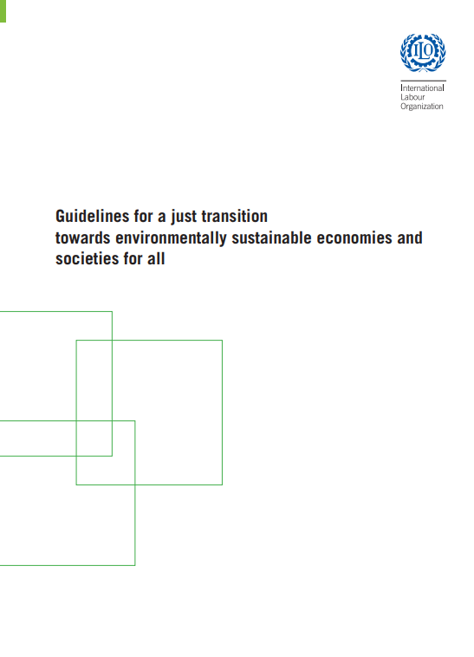
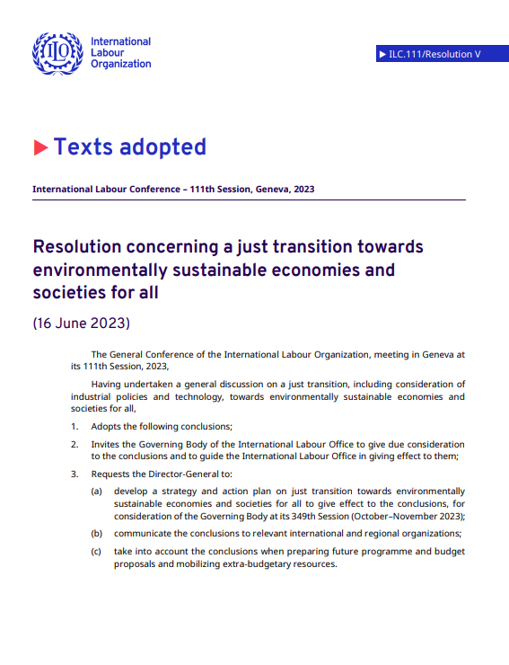
ILO Just Transition Framework
In 2015, the ILO adopted the policy guidelines for a just transition towards environmentally sustainable economies and societies for all.
Skills development & ALMPs
Key policy areas to address the environmental, economic and social sustainability.
In 2023, the Resolution and Conclusions adopted by 111th Session of the International Labour Conference (ILC) endorsed the ILO Just Transition Guidelines

Slide 4
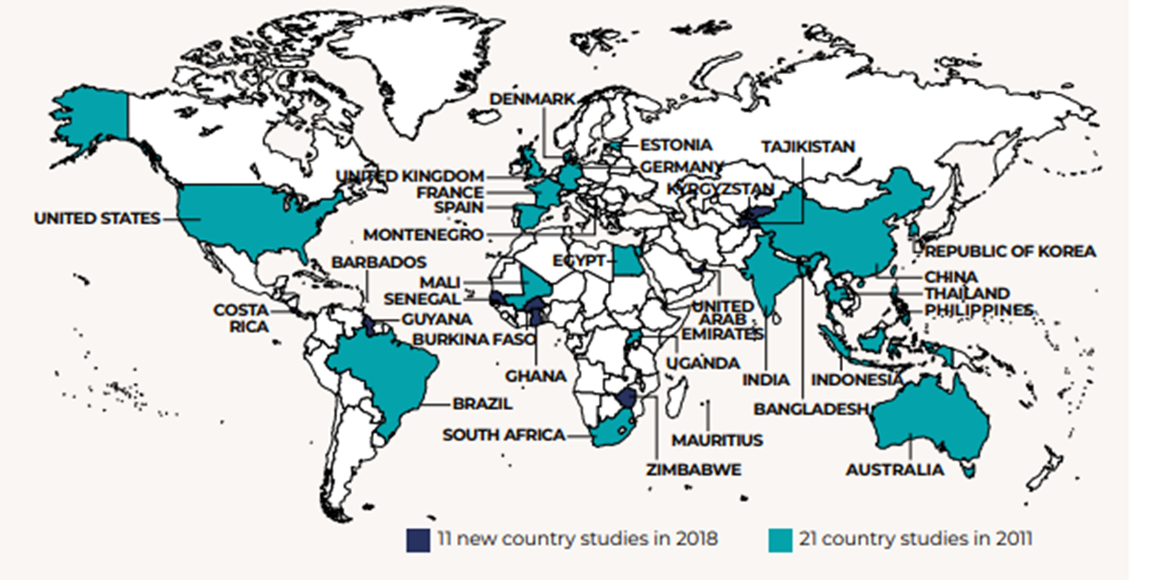
ILO Global Research: Skills for a Greener Future
Second round: 32 countries

Slide 5
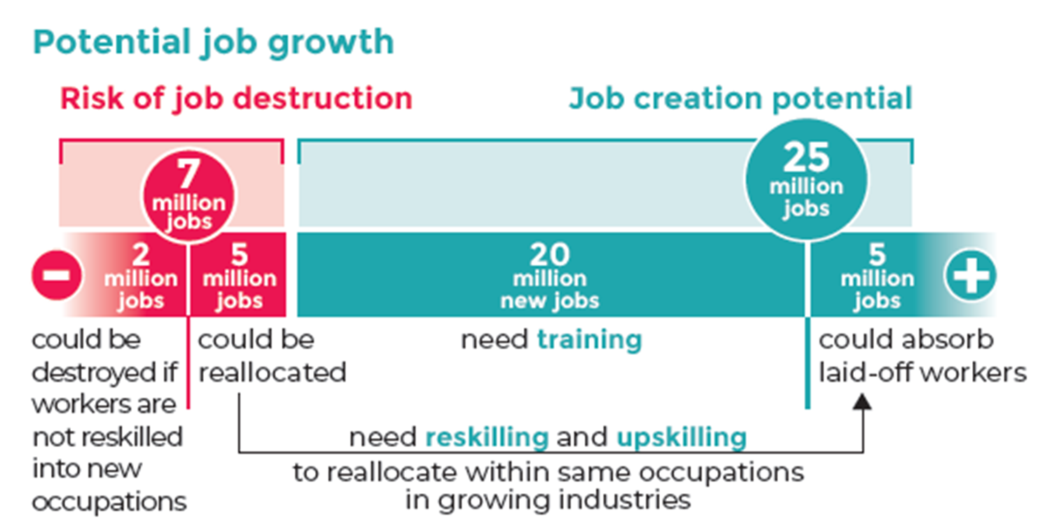
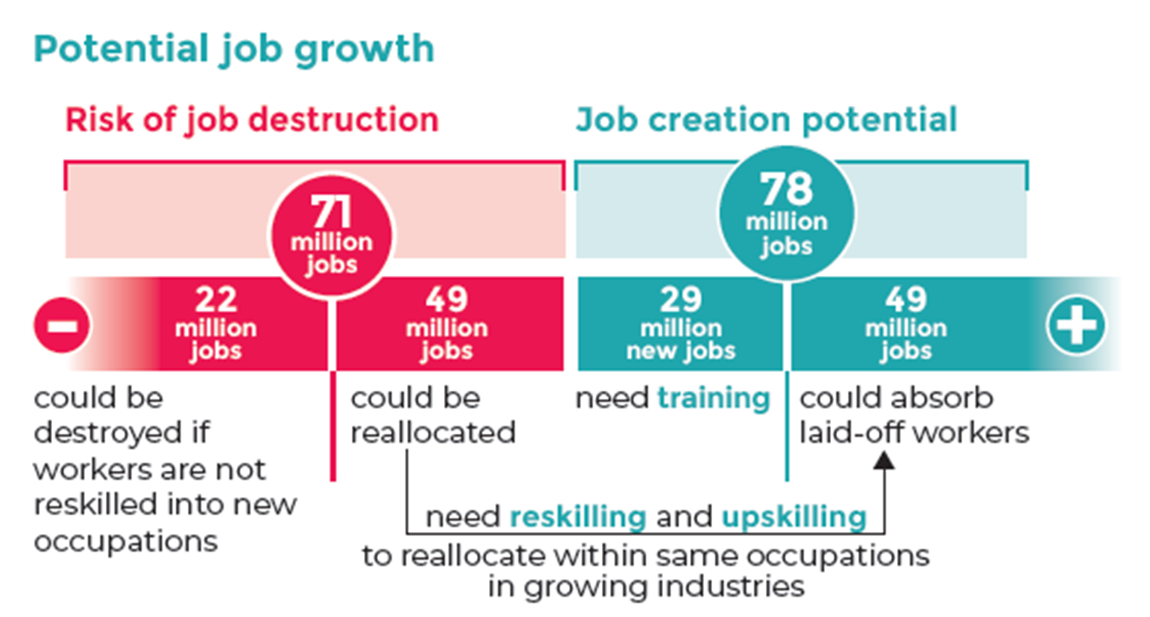
Global projections
Energy sustainability scenario, 2030
Circular economy scenario, 2030
Sources: ILO (2019) & Skills for a Greener Future. Infographic (2019).

Slide 6
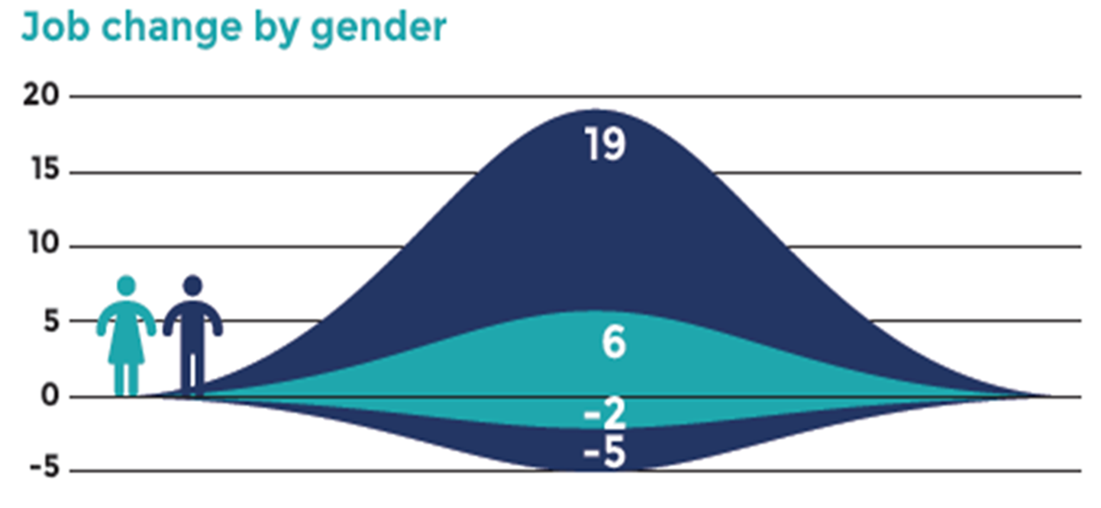
Gender Outlook in both global scenarios
Energy sustainability, 2030
Circular economy, 2030
Source: ILO (2019) Skills for a Greener Future. Infographic.

Slide 7
The green transition will have greatest effect in mid-skill occupations
Source: ILO(2019), Skills for a Greener Future. Infographic
Notes:
Greening TVET and skills development has a vital role to play in tackling the on-going challenges to our environment. It not only can support the green transformation of our societies and economies but also has the potential to lead the changes by equipping everyone with the knowledge, skills and behaviours they can use to transform their workplaces, communities and societies as a whole

Slide 8
Core employability skills are essential in just transition
Environmental awareness
Marketing skills to promote greener products & services
Strategic & leadership skills to enable policy-makers and businesses to set the right incentives for cleaner production and transportation
Teamwork & communication skills
Coordination,& management skills
Entrepreneurial skills
Occupational Safety and health (OSH)
Innovation & digital skills
Source: ILO(2019), Skills for a Greener Future
Notes:
This list of main core skills required for green transition are summary of the results of the global report on skills for a greener future.

Slide 9
Policy coherence and coordination
Comprehensive and coordinated approaches
Anticipation
of skills needs
Adapting curricula and competency standards
Social dialogue and institutional development
Skills development measures enable green transition
Adapting apprenticeship training, vocational education programmes and tertiary education
Active
labour market policies
Source: ILO(2019), Skills for a Greener Future.
Notes:
It is hard to overstate the importance of enhanced policy coherence between skills/sectoral/environmental policies and better-built institutional coordination among line ministries and agencies with the active involvement of social partners who have high stakes in the greening agenda. This is key for the effective design, planning, implementation and evaluation of policies on skills development for green jobs and climate action.
Effective mechanisms to anticipate and monitor skills needs for green jobs should also be put in place so that with better information and data on skills needs, we can make much more informed policy decisions and adapt curricula, competency standards, apprenticeship training and vocational education programmes to current and future demand more effectively.
We also need a complex set of policy measures, including active labour market policies, career guidance and counselling initiatives.

Slide 10
Key challenges related to the greening TVET agenda for a Just Transition
Lack of systemic and coordinated process to green TVET
Weakness in skills needs anticipation systems
Narrowness of approaches to greening in skills development
Inadequate consideration of inclusion issues
Supply-side challenges
Sources: Source: ILO(2019), Skills for a Greener Future
& ILO (2022), Greening TVET and Skills development: A practical guidance tool

Slide 11
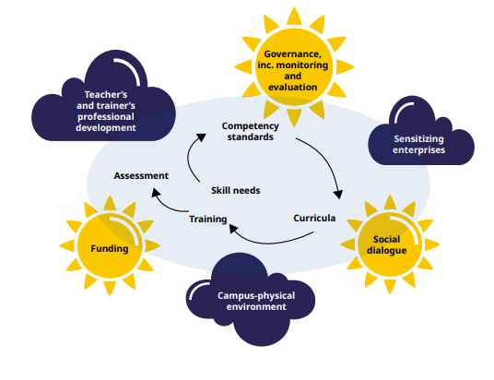
Key elements for greening TVET and skills development
A journey, not a destination
A normative process
Taking a long-term view
Holistic – relevant to every job
Systematic – covers all elements of TVET
TVET playing a lead role in greening the economy
Inclusive but aiming high!
Sources: ILO (2022), Greening TVET and Skills development: A practical guidance tool

Slide 12
ILO Greening TVET tool
Going green in training
Developing and implementing green curricula
Assessment packages to support greener learning
Aims
Provides practical ‘how-to’ guidance
For policy-making and delivery
From national to local level
Relevant to everyone involved:
Policy-makers
Social partners
Employers
School leaders
Teachers and trainers
Civil society
Designing competency standards for greener jobs
Towards a greener campus
Greening TVET: an overview
Greening the professional development of teachers / in-company trainers
Mainstreaming: from piloting to the whole system
Sensitizing enterprises
How to support greening of skills for the informal economy
Notes:
Using the tool:
Use as a stand-alone document or as part of coaching
Overall diagnosis is key but sections can be used independently
For all countries, but especially lower-income countries
Ambitious and inclusive

Slide 13
Benefits of the tool
Piloting countries (2021-2022)
Specific support measures
Ghana (sector skills bodies)
Zimbabwe (ToT & TVET action plan development)
Zambia (assessment of greening priorities at a Regional Training Centre)
Coaching programmes
Cambodia
Thailand
Philippines
Opportunities
Not just to green TVET
But to upgrade structures and processes more widely
And to link to wider social and economic greening strategies
Both learning and action-oriented
Flexibility – can be used on its own or with coaching

Slide 14
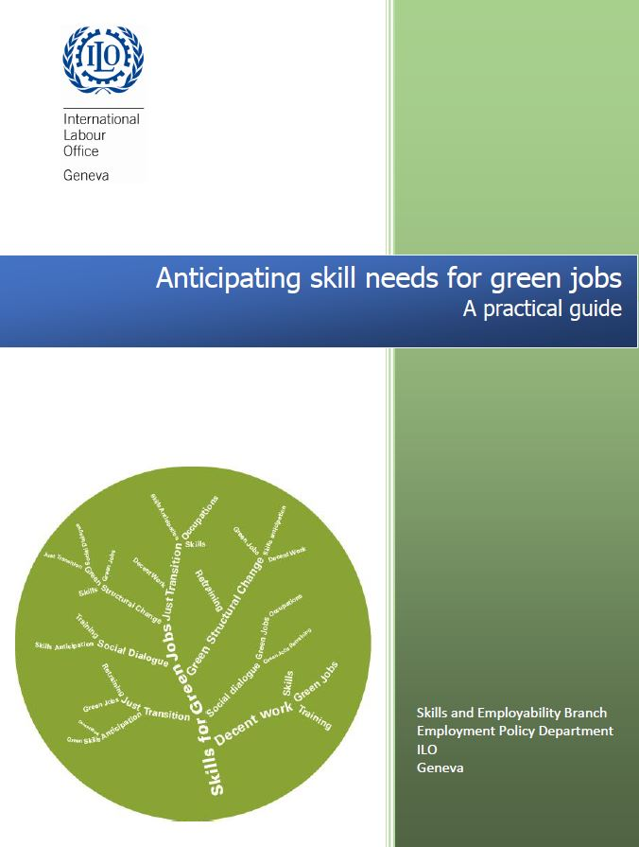
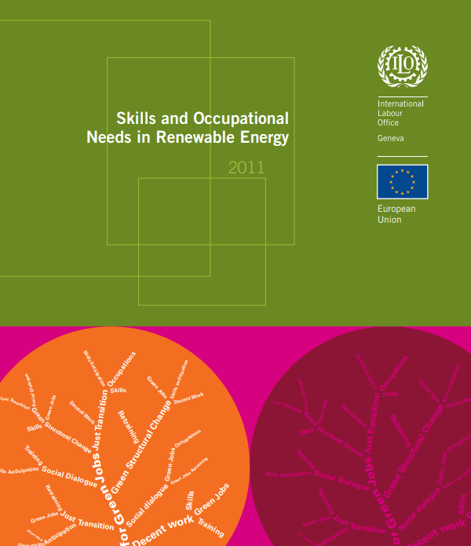
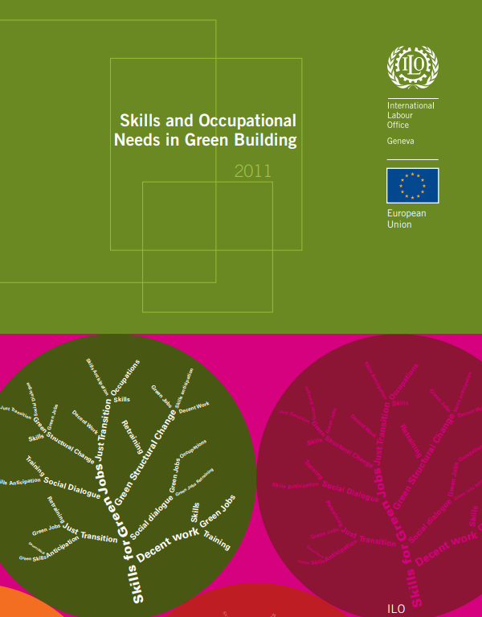
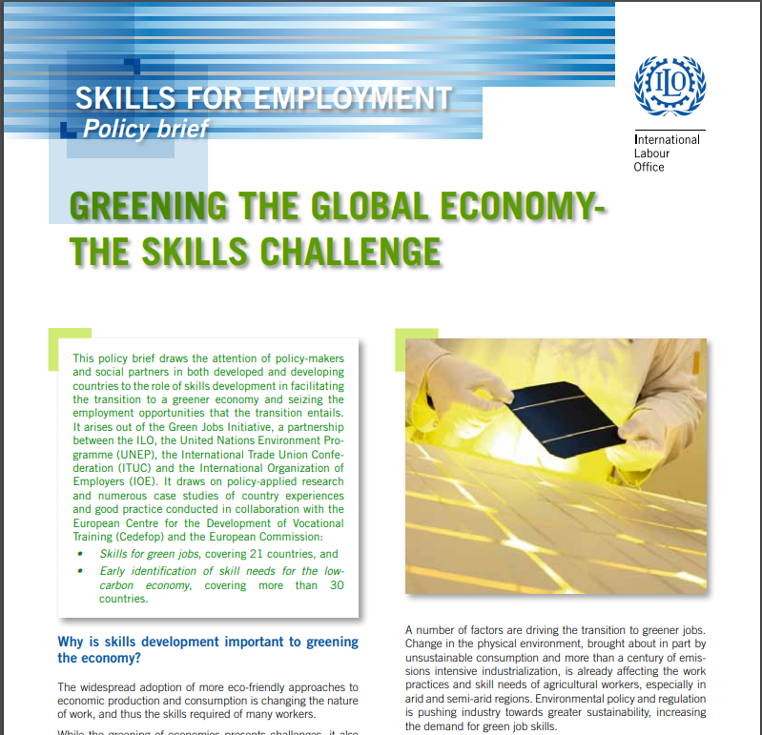
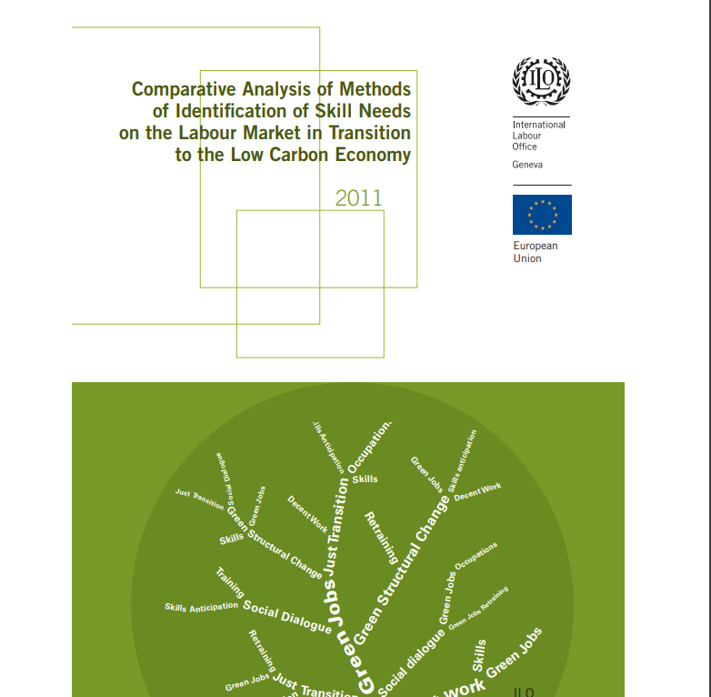
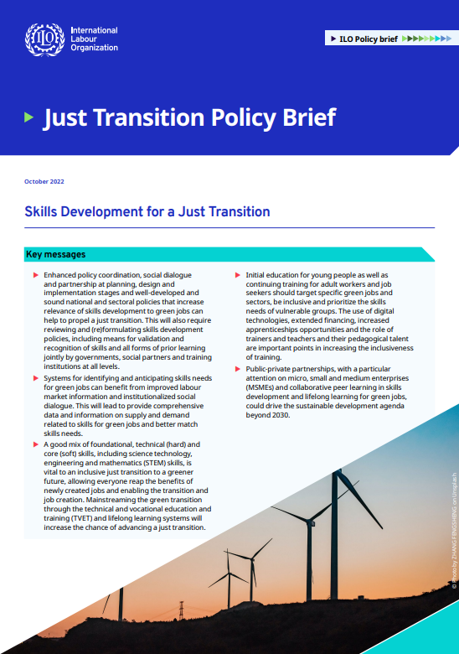
ILO knowledge products and tools on skills for a greener future
Skills and Occupation Needs in Renewable Energy
Skills and Occupation Needs in Green Building
Skills for a Greener Future: A global view
Anticipating skill needs for green jobs: A practical guide
Policy Brief: Challenges and enabling factors to achieve a just transition
Comparative analysis of methods of identification of skills needs on the labour market in transition to the low carbon economy
Skills for Green Jobs: A global view
For more information:
Greening TVET and skills development: A practical guidance tool
Just Transition Policy Brief: Skills development for a just transition
skills@ilo.org
ILO SKILLS - https://www.ilo.org/skills
Global KSP - https://www.skillsforemployment.org/skpEng

Slide 15
Thank you very much
Srinivas Reddy B
Chief of SKILLS Branch
ILO Geneva
reddy@ilo.org

